Slide 1

Guided by Submitted by Mr. Shiraz Husain Anshul Agrawal
Shri Vaishnav Vidyapeeth Vishwavidyalaya,
Indore (M.P)
Minor Project
Smart BILLING CART

Slide 2
Smart Billing Cart
Minor Project

Slide 3
Content
Introduction
About the device
Problem statement
Technology and design
Working
Future aspects
Conclusion

Slide 4
Problem Statement
Mall and market is a big corner for customer to purchase products that are essential in their day to day life.
Sometimes customers face problems regarding the incomplete information about the product and waiting at the billing counters.
Hence improvement is required in the traditional billing system to improve the quality of shopping for the customers.

Slide 5
About the project
The very basic idea of this project is to save time of customers and manpower required in mall.
Smart billing cart facilitates the customer to self scan the tags attached on each product to know the actual price of product.
The tedious work of scanning and billing every single at the cash counter can be avoided.

Slide 6
Introduction
“Smart billing cart” abbreviated as ABC is basically an automated device which overcome the problems of time consumed at the billing counter and improve the existing system.
This can be done by simply attaching RFID tags to the products and a RFID reader with LCD display on the shopping cart .
In this system, customer will know the price of each and every item that is scanned with the help of RFID. Total price of the item will be displayed on LCD and also brief about the product.

Slide 7
Why RFID?
At present, we are using the process in malls with help of barcode scanner. Vendor scan the product through the barcode scanner. This is to be a slow process and Customer has to wait for long queues.
So, this is a one of the reason for most of the people want to leave the mall for waiting a long queue to buy a few products. To avoid that, we want to buy more products recent years have been introduced new type of technologies.
Customer has to put a product into smart shopping trolley. Each and every product has product id. The RFID reader can read the product id. Which can have been useful for customers. All such solutions can be useful for customer. Such solutions save the customer time and money etc.

Slide 8
Technology and device
Components used-
Arduino UNO
LCD display (16x2)
RFID reader(EM-18)
RFID tags
Supply(5V,1A)

Slide 9
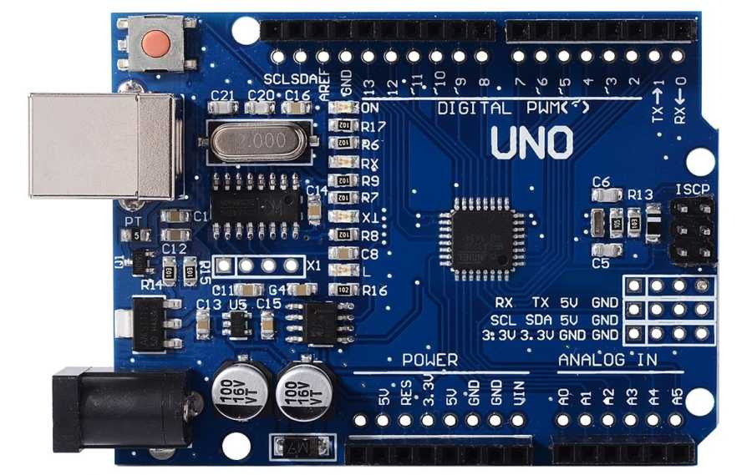
Arduino UNO R3-
The Arduino Uno is an open source microcontroller board based on the microchip AT- mega328 microcontroller and developed by Arduino.cc.
The board is equipped with sets of digital and analog input/output (I/O) pins that may be interfaced to various expansion boards (shields) and other circuits.
The board has 14 Digital pins, 6 Analog pins, and programmable with the Arduino IDE (Integrated Development Environment) via a type B USB cable.
It can be powered by the USB cable or by an external 9-volt battery, though it accepts voltages between 7 and 20 volts.

Slide 10
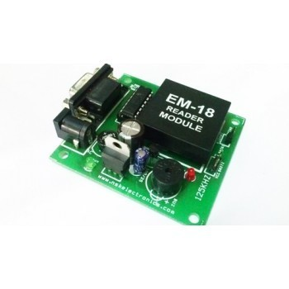
RFID Reader EM-18-
The reader emits radio waves in the ranges of anywhere from of 1 inch or 100 feet or more depending upon its power output and the radio frequency used.
When RFID tag passes through the electromagnetic zone, it detects the readers activation signal.
Carrier Frequency- 125KHz

Slide 11
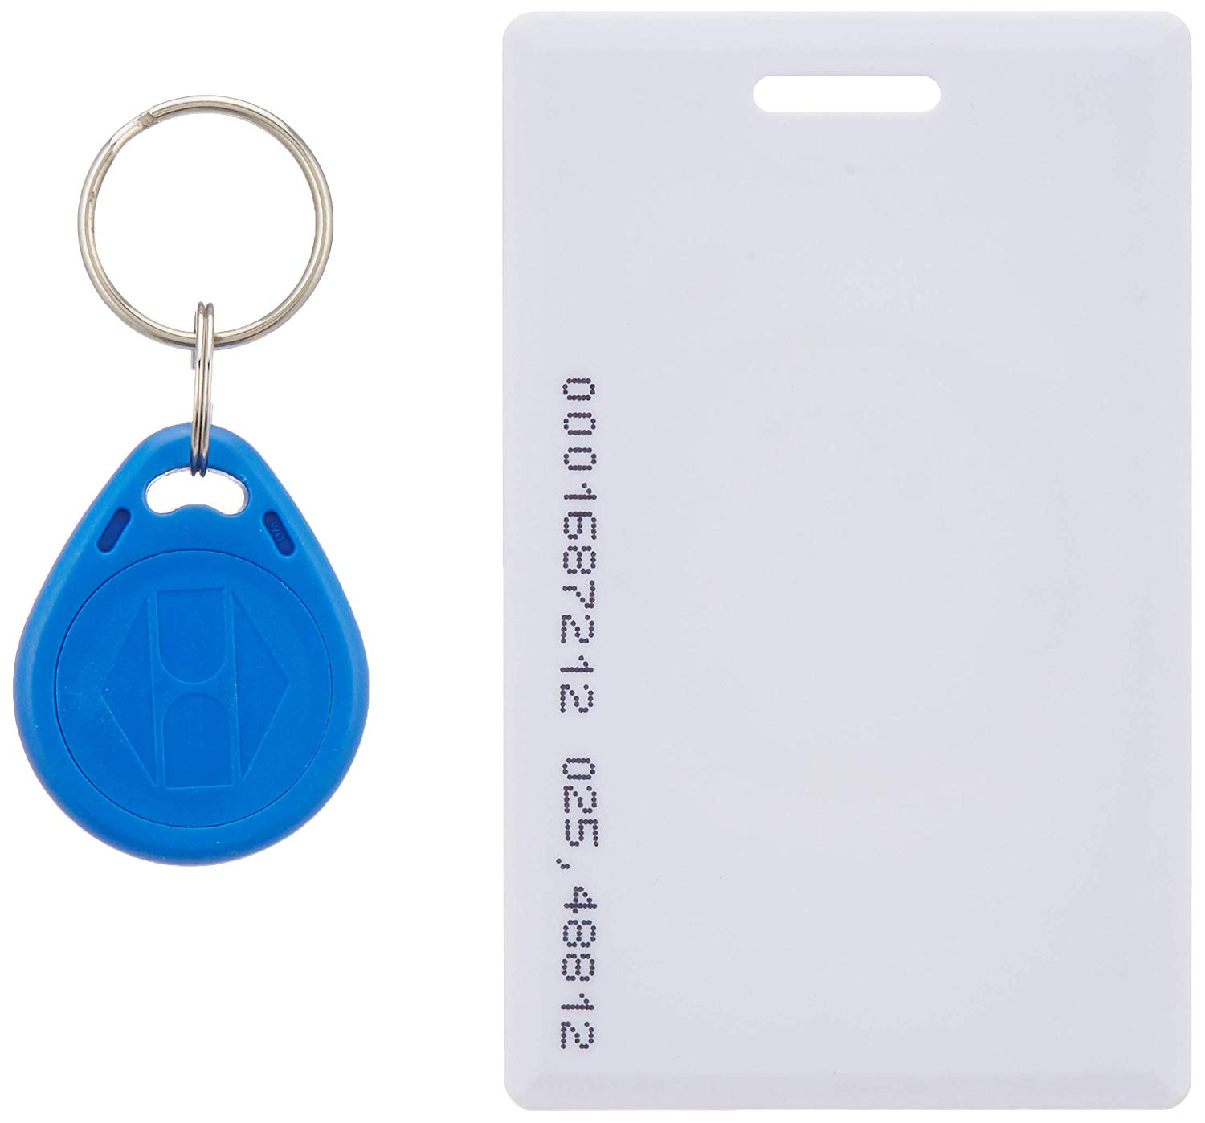
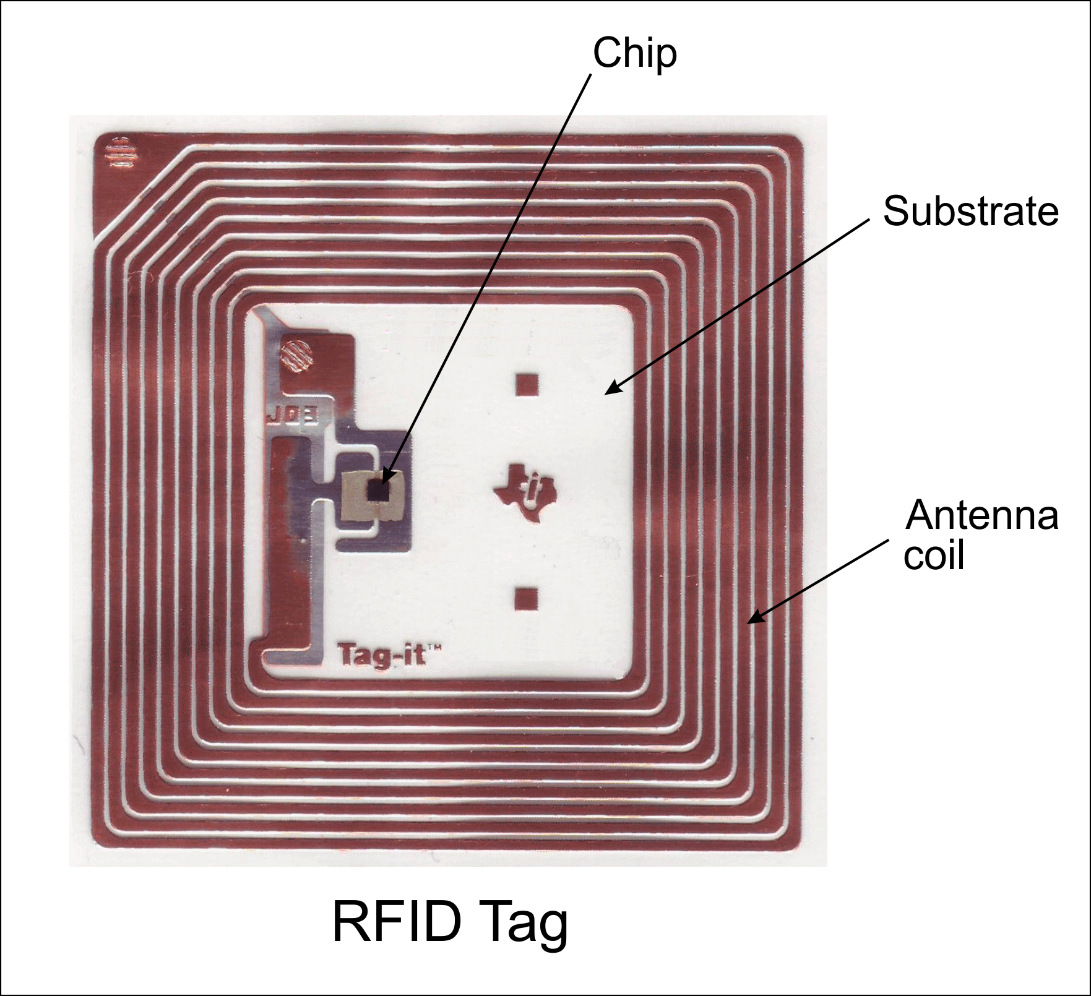
RFID tags-
Passive tags comprises of three main component namely, a in built chip, a substrate and an antenna.
A general RFID chip is competent of accumulating 96 bits but some other chips can store 1000-2000 bits of data as well.
Every RFID tag has unique ID number.

Slide 12
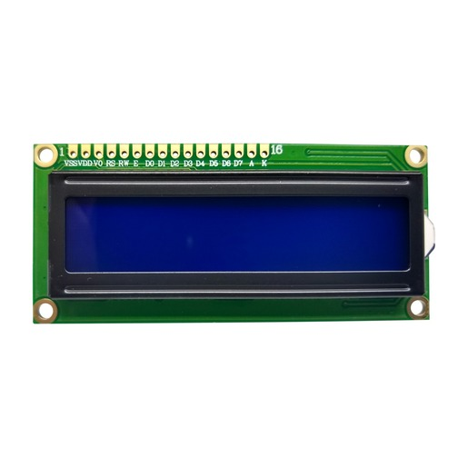
LCD display (16x2)
The 16x2 LCD display has a set commands each meant for doing particular job with the display.
Data pins are from D0 – D7. to use pins effectively we are using pins D4 – D7 which are connected to arduino board.
LCD dispaly in our project is used to display the product description and cost.

Slide 13
Block Diagram
Arduino UNO R3
board
LCD Display (16x2)
Power Supply
RFID Tag
RFID Reader
Switch
Buzzer

Slide 14
Working Procedure-
Step 1
Switch on the power supply of the hardware kit
Step 2
The LCD in the hardware displays “Welcome to trolley billing” after some delay it “displays waiting for the items”. Then add the items to the cart by keeping RFID tag near the RFID reader. Further the product information is displayed in the LCD screen
Step 3
While adding the items we can delete any of the item by pressing the prescribed switch then after LCD displays “item removed”
Step 4
After the completion of adding items. LCD displays the total amount which has to be paid at the cash counter.
‘

Slide 15
Start
Flow Chart
Initialise the system
Scan RFID tags
Is RFID tags
Read data from memory
Display on LCD
Add to total amount as items are added
yes
Total amount item cost
If item is removed
No

Slide 16
Continued…
Total amount will be same
Send the total amount
Print the bill
Stop

Slide 17
Algorithm
i. Start the process
ii. Initialize the system
iii. Scan an item in RFID tags
iv. Check the RFID tags
v. If the tag is registered or scanned, RFID reader can read the data related from memory
vi. Display the data and cost with help of LCD
vii. The item is added automatically the item cost also add and produce the total cost
viii. If any item is removed, the total cost is subtracted by the particular removed item and again the process will be continuing
ix. Total is displayed on the LCD screen

Slide 18
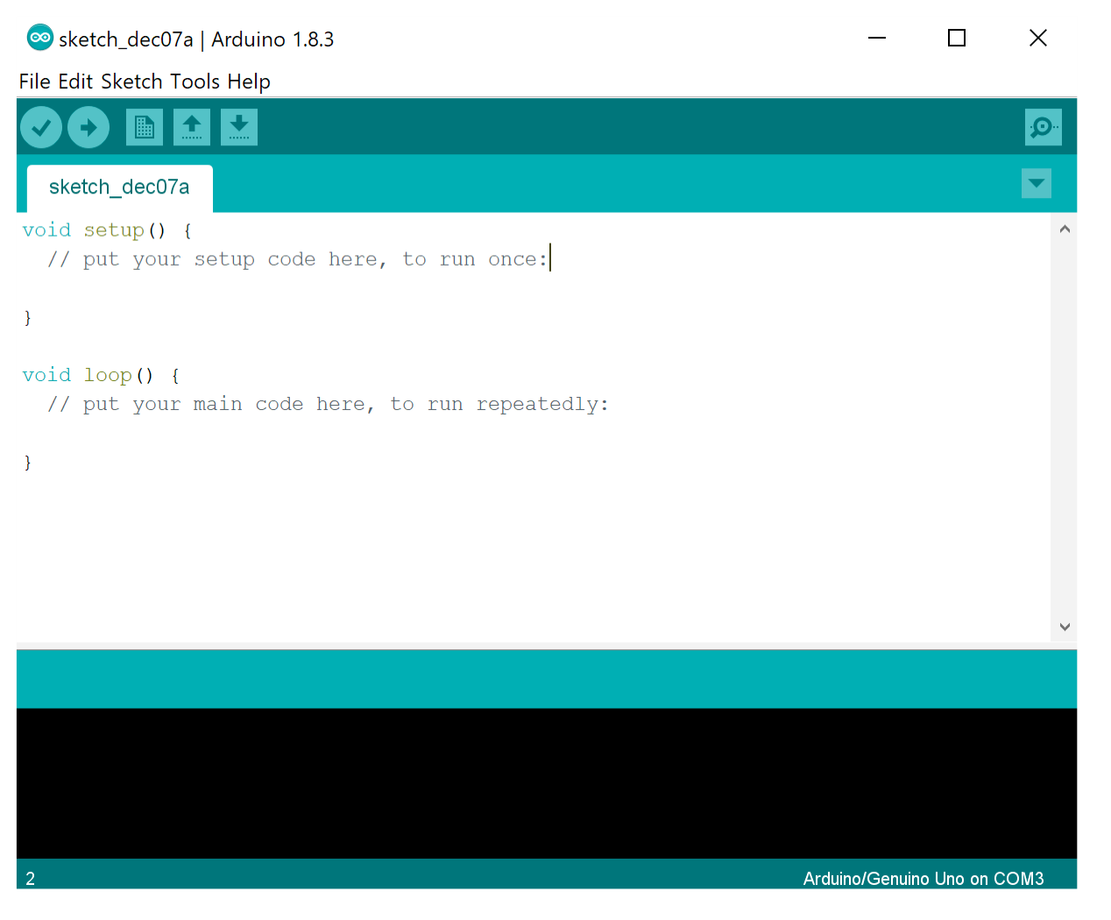
Software Used
Arduino UNO software

Slide 19
Advantages and Disadvantages
Advantages-
• It saves customers time.
• It also reduces the payoff given for workers.
• It is possible to rewrite the RFID tags.
• It doesn’t need line of sight.
Disadvantages-
• Easy to damage

Slide 20
Applications
This device can be used in various places such as-
a. Super Markets
b. Shopping centre
c. Grocery Shops

Slide 21
Project Costing
Arduino UNO R3 420rs
LCD screen 90rs
RFID reader (EM-18) 490rs
RFID Tags 120rs
Power supply 100rs
6. Other components 200rs
Total- 1420rs

Slide 22
Conclusion and Future scope
Smart shopping trolley application creates an automated central billing system in malls. By using the ZigBee, the product information are directly sent to billing system. So that customers no need to wait in a long queue.
It is trustworthy, highly dependable and time efficiency. The proposed smart shopping trolley system will reduce the customers time in searching the location of the product.
The customer just types the name of the product he/she want to purchase on android device. The trolley will automatically guide them to the location of the product.

Slide 23
Thank you

